Slide 1
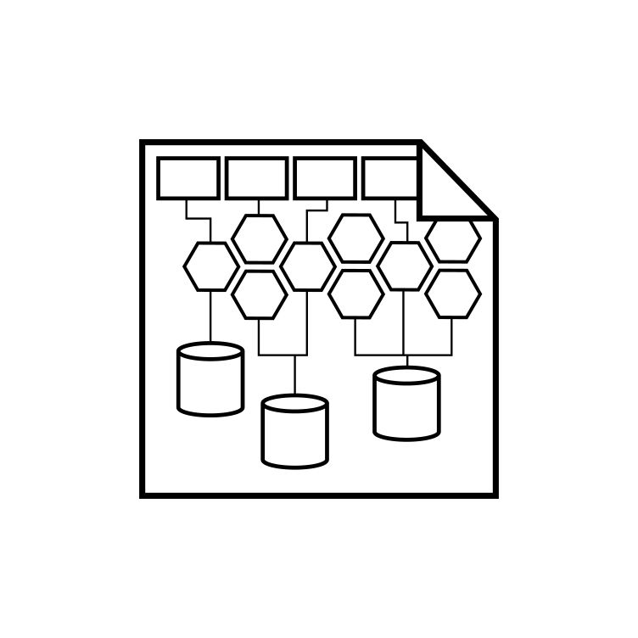
Android Architectural Patterns
2023-24

Slide 2
Application architecture
In a very abstract way, an application is a piece of software that manages a given set of data according to some business rules
The user interface of the application depicts (a derivation of) the internal data
When the user interacts with the application (or, sometimes, when time elapses), internal data are evolved according to the business rules, and the user interface is updated accordingly
If the data set is small and business rules are simple, conceiving such a software is not usually a problem
But as the size of the application increases, complexity increases much more rapidly, requiring a highly structured approach to software design aimed at dooming such a complexity

Slide 3
Architectural patterns
Architectural patterns are a general, reusable resolution to a commonly occurring problem in conceiving software, within a given context
Possibly addressing issues of different kinds: software issues (maintainability, evolvability, testability, …), operational issues (availability, scalability, …), business issues (time to market, total cost of ownership, …)
Along time, different patterns have emerged, aimed at solving some specific problem that previous approaches did not cope with in an adequate way
Either because the context had changed, due to technological and socio-economic evolutions
Or because they had not emerged, yet, due to the relatively short history of their usage

Slide 4
Android application architecture
Android applications are built by putting together a series of components that are managed directly by the OS
Activities, Services, Content providers, Broadcast receivers
Components can be launched individually and out-of-order, and can be destroyed at anytime by the user or by the system
This may lead to unexpected sequences of events that makes designing and testing an app a difficult task

Slide 5
Separation of concerns
No top-level component should store, inside its own properties, application data or information about its state
Since it can be destroyed by the OS at its own will, and that could cause a loss of data
Moreover, no component should depend on the (active) existence of another, unless a specific contract or API provides this kind of guarantee (e.g., a bound service)
Asynchronous operations (like interacting with a remote server or performing computations in other threads) are particularly problematic
When the response arrives, the component that originated the request, may exist no more

Slide 6
Separation of concerns
Classes extending Activity and Fragment should only deal with UI or operating system interactions
These classes are intended to be glue classes and can be destroyed at any moment by the user or by the OS
The content of the UI should reflect a model, preferably a persistent one
Users will not lose data if the app gets destroyed
Your app will work even on problematic network connections

Slide 7
What is in the application state?
Application data evolve across time as the user interacts
Application should keep this data consistent with both the user actions and the business rules it enforces
State may span across several levels
UI state (is the menu open or closed?)
Form state (what is currently entered into each input)
Application state (the personal profile object, that you can edit)
Read-only data (all the articles in the blog section of the application)
…
Some data may be just a cache of a remote db, some must be kept in sync with the remote db, some is local to the device
Where and how should they be stored and processed?

Slide 8
Architecting a general solution
The problem of how to properly organize code in order to cope with these problems has received, along time, several responses which, in turn, have led to different architectural patterns
Model-View-Controller (MVC)
Model-View-Presenter (MVP)
Model-View-ViewModel (MVVM)
Google recommends the last one and supports it with several enhancements in its libraries

Slide 9
Model-View-Controller
Model - Business logic
This is the source of truth for data
Its methods evolve data according to the business rules
It may operate as a proxy for a remote server
View - Data presentation
This is the GUI
It depicts model data and collects user interactions
Controller - Model manipulation
Transforms user interactions into operations onto the model
User interactions
View
Passes calls to
Fires events
Controller
Model
Manipulates

Slide 10
MVC - Pros & cons
Pros
Clear separation of concerns, defining a precise purpose for each of the three components
Model testability
Cons
High coupling among the classes: when one component changes, the other must change, too
A single component cannot be replaced without replacing also the others

Slide 11
Model-View-Presenter
Model - Business logic
This is the source of truth for data
Its methods evolve data according to the business rules
It may operate as a proxy for a remote server
View - Data presentation
This is the GUI
It depicts model data and collects user interactions
Presenter - Model and View manipulation
Transforms user interactions into operations onto the model
Updates the view according to model
User interactions
Passes calls to
View
Updates
Presenter
Fires events
Model
Manipulates

Slide 12
MVP - Pros & cons
Pros
Clear separation of concerns as in MVC
View and Model are now decoupled: they can change independently of each other
Improved testability
Cons
Programmatic manipulation of the View can be problematic: depending on the technology used for implementing the View, a lot of complexity may be introduced due to synchronization issues

Slide 13
Model-View-ViewModel
Model - Business logic
This is the source of truth for data
Its methods evolve data according to the business rules
It may operate as a proxy for a remote server
View - Data presentation
This is the GUI
It depicts model data and collects user interactions
ViewModel - Model manipulation and View data feeding
Transforms user interactions into operations onto the model
Hosts the subset of Model data that View observes
User interactions
Passes calls to
View
Fires events
ViewModel
Fires events
Model
Manipulates

Slide 14
MVVM - Pros & cons
Pros
Clear separation of concerns as in MVC and MVP
Higher decoupling, since there are no direct invocations from ViewModel to View
Less synchronization problems
Improved testability
Cons
Higher complexity, which can be partially smoothed by leveraging on well architected frameworks
Steeper learning curve

Slide 15
MVVM Architecture in Android
Activity/Fragment
View
ViewModel
ViewModel
LiveData/ State/StateFlow
LiveData/ State/StateFlow
Model
BusinessLogic
Local Data Source
Remote Data Source
Room
Retrofit
references
SQLite
Network
notifies

Slide 16
ViewModel
Object designed to store and manage UI-related data in a lifecycle conscious way
And to propagate change requests to the underlying model
Indirectly instantiated inside an activity or a fragment, using a delegate property
This allows to rebind the same ViewModel when the activity/fragment is destroyed and recreated as a consequence of a configuration change (device rotation, change in the UI language, …)
When the owning component is finished, the ViewModel is notified
Via the onCleared() method
ViewModels must extend the androidx.lifecycle.ViewModel abstract class
Or a subclass of it, like AndroidViewModel

Slide 17
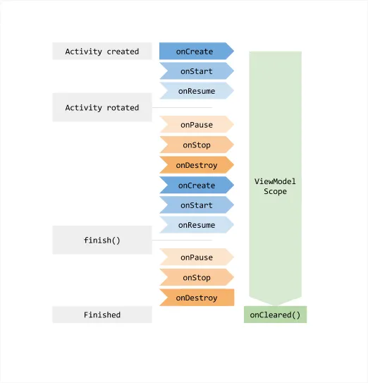


ViewModel lifecycle
ViewModel instances have a special status in Android, since they are always created in association with a scope (a fragment or an activity) and are retained as long as the scope is alive
This means that they survive configuration changes
E.g., they are kept in memory when a device is rotated and associated back to their scope as soon as it is recreated

Slide 18
Implementing a ViewModel
Given its role of mediator between the View and the Model, a ViewModel should offer a set of methods invocable from the View to operate on the Model
These methods can simply invoke the corresponding Model methods, or may add some presentation logic (e.g., causing a loading animation to be displayed) to them
At the same time, the ViewModel must host a set of observable properties, that the View may subscribe to, representing relevant Model data to be displayed
Android offers several abstractions useful for this, like LiveData<T>, State<T>, StateFlow<T>, SharedFlow<T>, as well as their mutable counterparts (Mutable*)

Slide 19
Using observables in ViewModels
Observability refers to the capability of an object to notify others about changes in its data
Notification are sent to subscribers, and each observable kind provide its own way to subscribe/unsubscribe
Observables have in common a read only property named value
Mutable observables give write access to such a property
ViewModels usually declare a private mutable observable properties
And expose them as public read-only ones
class MyViewModel: ViewModel() {
private val _someData = mutableLiveData<Int>(0)
val someData: LiveData<Int> = _someData
}

Slide 20
Which observable should be used?
It depends on the technology used by the GUI
LiveData<T> works smoothly with standard View objects, since they inherit the LifeCycle state from the Activity/Fragment they are hosted in
State<T> is intended for Jetpack Compose GUIs - a change in its value automatically triggers recomposition, but it is complex to use it outside of that framework
SharedFlow<T> and its subclass StateFlow<T> are part of the Kotlin coroutine libraries and provide a general solution to observability that is independent of the Android framework
Extension functions are provided for accessing observables in Compose
A LiveData can be converted into a State by using .observeAsState()
A StateFlow con be converted into a State via .collectAsState()

Slide 21
What VMs should not contain
A ViewModel must never reference a view or any class that may hold a reference to the activity context
Views, fragments, adapters, drawables, lifecycles, lifecycle-aware observables, …
Resources must only be referred to by their ids, and should be loaded by the view
The only exception to this rule is ApplicationContext
Since that object lifecycle spans the entire duration of the process, it is safe to store it inside a ViewModel instance
Class AndroidViewModel, which can be used as super-class of ViewModels, requires the application object to be constructed
Android code that instantiates a class deriving from it will automatically inject the Application object into the ViewModel

Slide 22
Buffering view state data
A ViewModel is the natural place where view state can be hoisted
This gives the possibility to mutate several different properties as a consequence of a single method invocation
Methods that propagate change requests to the Model may require switching to a different thread
Android forbids, in fact, performing long running operations from the main thread
ViewModels can also be used as a communication layer between the different fragments hosted inside the same activity
This decouples the data exchange allowing fragments to interact without necessarily being alive at the same time

Slide 23
ViewModel example (LiveData)
class CounterViewModel : ViewModel() {
private val _count = MutableLiveData<Int>(0)
val count: LiveData<Int> = _count
fun increment() { _count.value = _count.value!! + 1 }
fun decrement() { _count.value = _count.value!! - 1 }
}

Slide 24
ViewModel example (State)
class CounterViewModel : ViewModel() {
private val _count = mutableStateOf(0)
val count: State<Int> = _count
fun increment() { _count.value ++ }
fun decrement() { _count.value -- }
}

Slide 25
ViewModel example (StateFlow)
class CounterViewModel : ViewModel() {
private val _count = MutableStateFlow(0)
val count: StateFlow<Int> = _count
fun increment() { _count.value ++ }
fun decrement() { _count.value -- }
}

Slide 26
What is behind a ViewModel?
No magics!
Android defines the androidx.lifecycle.ViewModel class and make some provisions to keep it alive across configuration changes
This requires a special way to instantiate ViewModels
They need to be created in association with a scope (a Fragment or an Activity)
They are retained while the scope is alive

Slide 27
Using a ViewModel inside an Activity
class MyActivity: AppCompatActivity {
private lateinit var vm: MyViewModel
fun onCreate(savedInstanceState:Bundle) {
super.onCreate(savedInstanceState) // This creates a ViewModel the first time
// the system calls an activity's onCreate() method
vm = ViewModelProvider(this)[ MyViewModel::class.java ];
vm.getUsers().observe(this, Observer { users -> // update UI }); } }

Slide 28
Using a ViewModel in an Activity
Alternative code to the one in the previous slide
It requires a proper project setup
public class MyActivity extends AppCompatActivity {
private val vm by viewModels< MyViewModel >() override fun onCreate(savedInstanceState: Bundle) {
super.onCreate(savedInstanceState) vm.getUsers().observe(this, Observer { users -> // update UI }) } }

Slide 29
Project setup
android {
...
kotlinOptions { jvmTarget = '1.8' }
}
dependencies {
// Activity
implementation 'androidx.activity:activity-ktx:1.8.2'
// Fragment (optional)
implementation 'androidx.fragment:fragment-ktx:1.5.6'
// ViewModel
implementation "androidx.lifecycle:lifecycle-viewmodel-ktx:2.6.2"
// LiveData
implementation "androidx.lifecycle:lifecycle-livedata-ktx:2.6.2"
// Navigation (optional)
implementation "androidx.navigation:navigation-ui-ktx:2.6.2"
implementation "androidx.navigation:navigation-fragment-ktx:2.6.2"
}

Slide 30
The viewModels() function
Extension function applied to activity/fragment returning a ViewModel tied to the invoker object
Part of the activity-ktx library
Lazily returns a viewModel of the target class (i.e., the class of the variable to be assigned) and stores it in the activity's ViewModelStore using the class name as a key
If the same class will be requested in future by an activity having the same ViewModelStore, the current instance will be returned
This is what makes the ViewModel "special" with respect to the activity life-cycle

Slide 31
ViewModel in fragments
A fragment can be tied to its own ViewModels (via by viewModels() )
Or reuse a ViewModel tied to the enclosing activity (via by activityViewModels() )
Or even one tied to the current NavigationGraph (via by navGraphViewModels(…) )
Useful for managing the business logic of related parts of the app
A ViewModelFactory can be provided to these functions in order to pass parameters to the ViewModel, if it has not been created, yet

Slide 32
Sharing a VM with fragments
class SomeFragment : Fragment() {
private lateinit var vm : MyViewModel
override fun onStart() {
super.onStart()
vm = ViewModelProvider(activity) [MyViewModel::class.java]
} }
class OtherFragment: Fragment() {
private val vm : MyViewModel by activityViewModels() }

Slide 33
ViewModels in Compose
A composable function can access a ViewModel connected to the current activity via the androidx.lifecycle.viewmodel.compose.viewModel() function
class MainViewModel: ViewModel() {
val p1: State<Int> = …
val p2: LiveData<String> = …
val p3: StateFlow<Float> = …
// More properties and methods
}
@Composable
fun InputPane(
vm: MainViewModel = viewModel()) {
val p1 = vm.p1 //direct access
val p2 = vm.p2.observeAsState()
val p3 = vm.p3.collectAsState()
// whenever the properties change
// a recomposition will occur
}

Slide 34
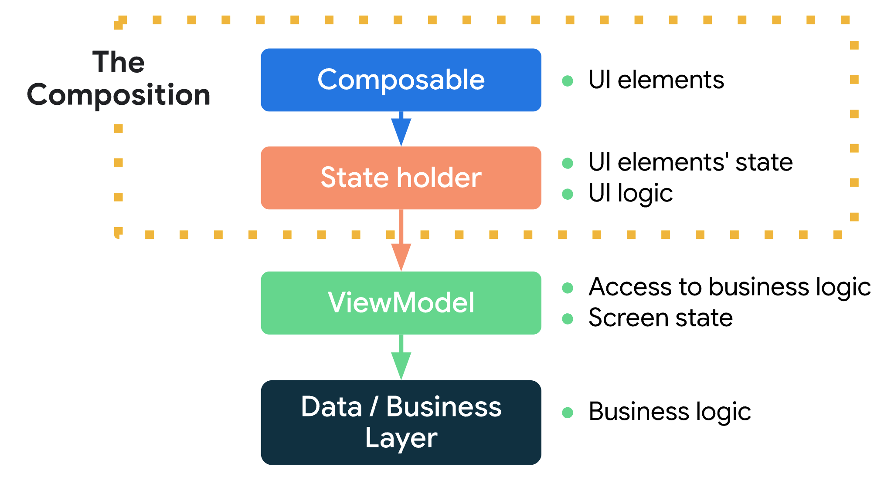
ViewModels in Compose
https://developer.android.com/jetpack/compose/state#managing-state

Slide 35
Lifecycle architectural components
Package androidx.lifecycle contains classes and interfaces that tackle lifecycle problems in a resilient and isolated way
Class Lifecycle
Holds the information about a component’s lifecycle and makes it observable
Events and State enums are used to track the state of the related component

Slide 36
LifecycleObserver
Marker interface (i.e., it contains no methods) that allows a class to monitor the lifecycle of a LifecycleOwner component, by adding annotations to its own methods
Classes Fragment and AppCompatActivity implement the LifecycleOwner interface and can thus be monitored
class MyObserver : LifecycleObserver { @OnLifecycleEvent(Lifecycle.Event.ON_RESUME) fun connectListener() { … } @OnLifecycleEvent(Lifecycle.Event.ON_PAUSE) fun disconnectListener() { … } }
myActivity.getLifecycle().addObserver(MyObserver());

Slide 37
ProcessLifecycleOwner
When an application consists of many views (activities and fragment), it may be interesting to detect when it is in use (foreground), and when it is not
This is a typical use case for analytics
Although it is possible to detect this by observing and combining the state of each single view, the task may become complex
Class ProcessLifecycleOwner offers a simple solution to this scenario
It offers the static method get() that returns its singleton instance and an the instance-level property lifecycle that gives access to the process lifecycle
Event ON_CREATE is dispatched once, when the application starts, ON_DESTROY is never dispatched, ON_START is dispatched when the first activity becomes visible, and ON_STOP is dispatched some delay after the last activity is no more visible

Slide 38
ProcessLifecycleOwner
class AnalyticsReporter: LifecycleEventObserver {
override fun onStateChanged(source: LifecycleOwner, event: Lifecycle.Event) {
when (event.name) {
"ON_START" ->
// Application in foreground
"ON_STOP" ->
// Application in background
else -> {}
}
}
class MainActivity: AppCompatActivity() {
override fun onCreate(b: Bundle?) {
super.onCreate(b)
ProcessLifecycleOwner.get().lifecycle.addObserver(AnalyticsReporter())
setContentView(R.layout.activity_main)
}
}

Slide 39
LiveData
An observable data holder class
That notifies its observer when the underlying data change, provided its lifecycle is at least in the STARTED state
In order to access the value contained, the observe(...) method must be invoked
This will trigger a callback providing the current value (if any) and any future value the LiveData may contain
Observations are lifecycle-aware
In order to observe changes, a LifecycleOwner object must be provided
This acts as a guard: value changes are notified only when the owner in an active state (STARTED or RESUMED)
If the owner moves to the DESTROYED state, the observer will be removed

Slide 40
LiveData
class BusinessLogic(private val webService: WebAPI) {
fun getUser(userId: String): LiveData<User> {
val data = MutableLiveData<User>()
webService.getUser(userId) {
// SIMPLIFIED CODE: NO ERROR CHECKING !!!
response -> data.value = response.body()
};
return data
}
}
Initially empty!
When the callback is called, a value will be stored inside it. This happens LATER!
Still empty when the function returns!

Slide 41
Observing LiveData
An Activity or a Fragment can easily observe LiveData values
The former being a LifecycleOwner, the latter having a viewLifecycleOwner property that can be used as the first argument of the observe(...) method invocation
Objects that do not implement the LifecycleOwner interface (e.g., the ViewModel) can access the encapsulated value in two ways
Either invoking the observeForever(...) method, and taking care to invoke removeObserver(...) at the end of their own existence
Or using the Transformations.map(...) function to produce a new LiveData object publishing a derived value out of any incoming value in the observed one

Slide 42
Observing LiveData in activities
override fun onCreate(savedInstanceState: Bundle) { super.onCreate(savedInstanceState) setContentView(R.layout.my_activity) // Other code to setup the activity... val nameView = findViewById<TextView>(…)
val userRepository = … val userId = … val liveData = userRepository.getUser(userId)
// Observe the LiveData, passing in this activity
// as the LifecycleOwner and the observer liveData.observe(this) { // Update the UI user -> nameView.setText(user.name) } }

Slide 43
LiveData – updating the value
LiveData only provides read access to the encapsulated content
Subclass MutableLiveData<T> provides write access via the value property (which can be set only in the main thread) or via the postValue(...) method (which can be invoked from any thread)
When a MutableLiveData is created, it is empty
The apply() scoped function is typically used to provide an initial value
LiveData can be transformed via .map(…) and propagated
val userLD: MutableLiveData<User>().apply{ value = … } val userName: LiveData<String> = userLD.map { user -> "${user.name} ${user.lastName}" }

Slide 44
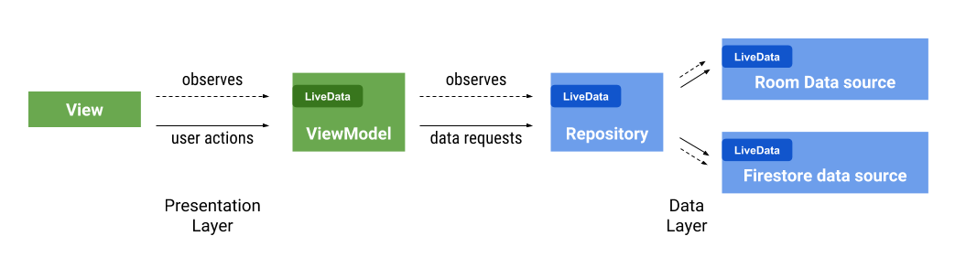
Connecting components

Slide 45
Merging multiple LiveData sources
Dealing with multiple asynchronous data is difficult
Multiple callbacks to handle
Class MediatorLiveData can be used to merge this data together by creating a single source of the merged data
val offline = LiveData<Bool> = ... //are we offline?
val userLD1: LiveData<User> = ... //from DBMS
val userLD2: LiveData<User> = ... //from API
val userLD = MediatorLiveData<>()
userLD.addSource(userLD1) {
if (offline.value) userLD.value = it.value
}
userLD.addSource(userLD2) {
userLD.value = it.value
}

Slide 46
LiveData - advantages
No memory leaks
No crashes due to stopped activities
No manual lifecycle handling
Always up to date data
Proper configuration change handling
Sharing resources
You can wrap system services with LiveData
The LiveData object connects once to the system service and observers just watch the object for changes

Slide 47

Learning more
MVI Architecture with Android
https://medium.com/swlh/mvi-architecture-with-android-fcde123e3c4a
Exploring Data Observables in Android: LiveData, Flow, StateFlow, and SharedFlow
https://medium.com/@summitkumar/exploring-data-observables-in-android-livedata-flow-stateflow-and-sharedflow-75b7ce189a79

